Slide 1



Expense tracker
Name: Dev Jitendrabhai Bhavsar
Branch: AIDS
Batch: A8
Roll no: 283
Enrollment no: 21002170510002
Notes:
Line spacing + Page numbers

Slide 2
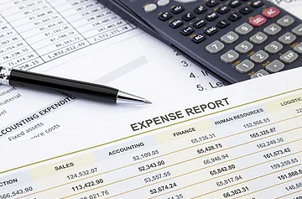


Introduction
01
Profits are up, and losses are down!
This is a basic expense tracker app made using React JS in which you can add your income and spend accordingly .

Slide 3



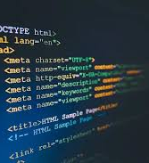
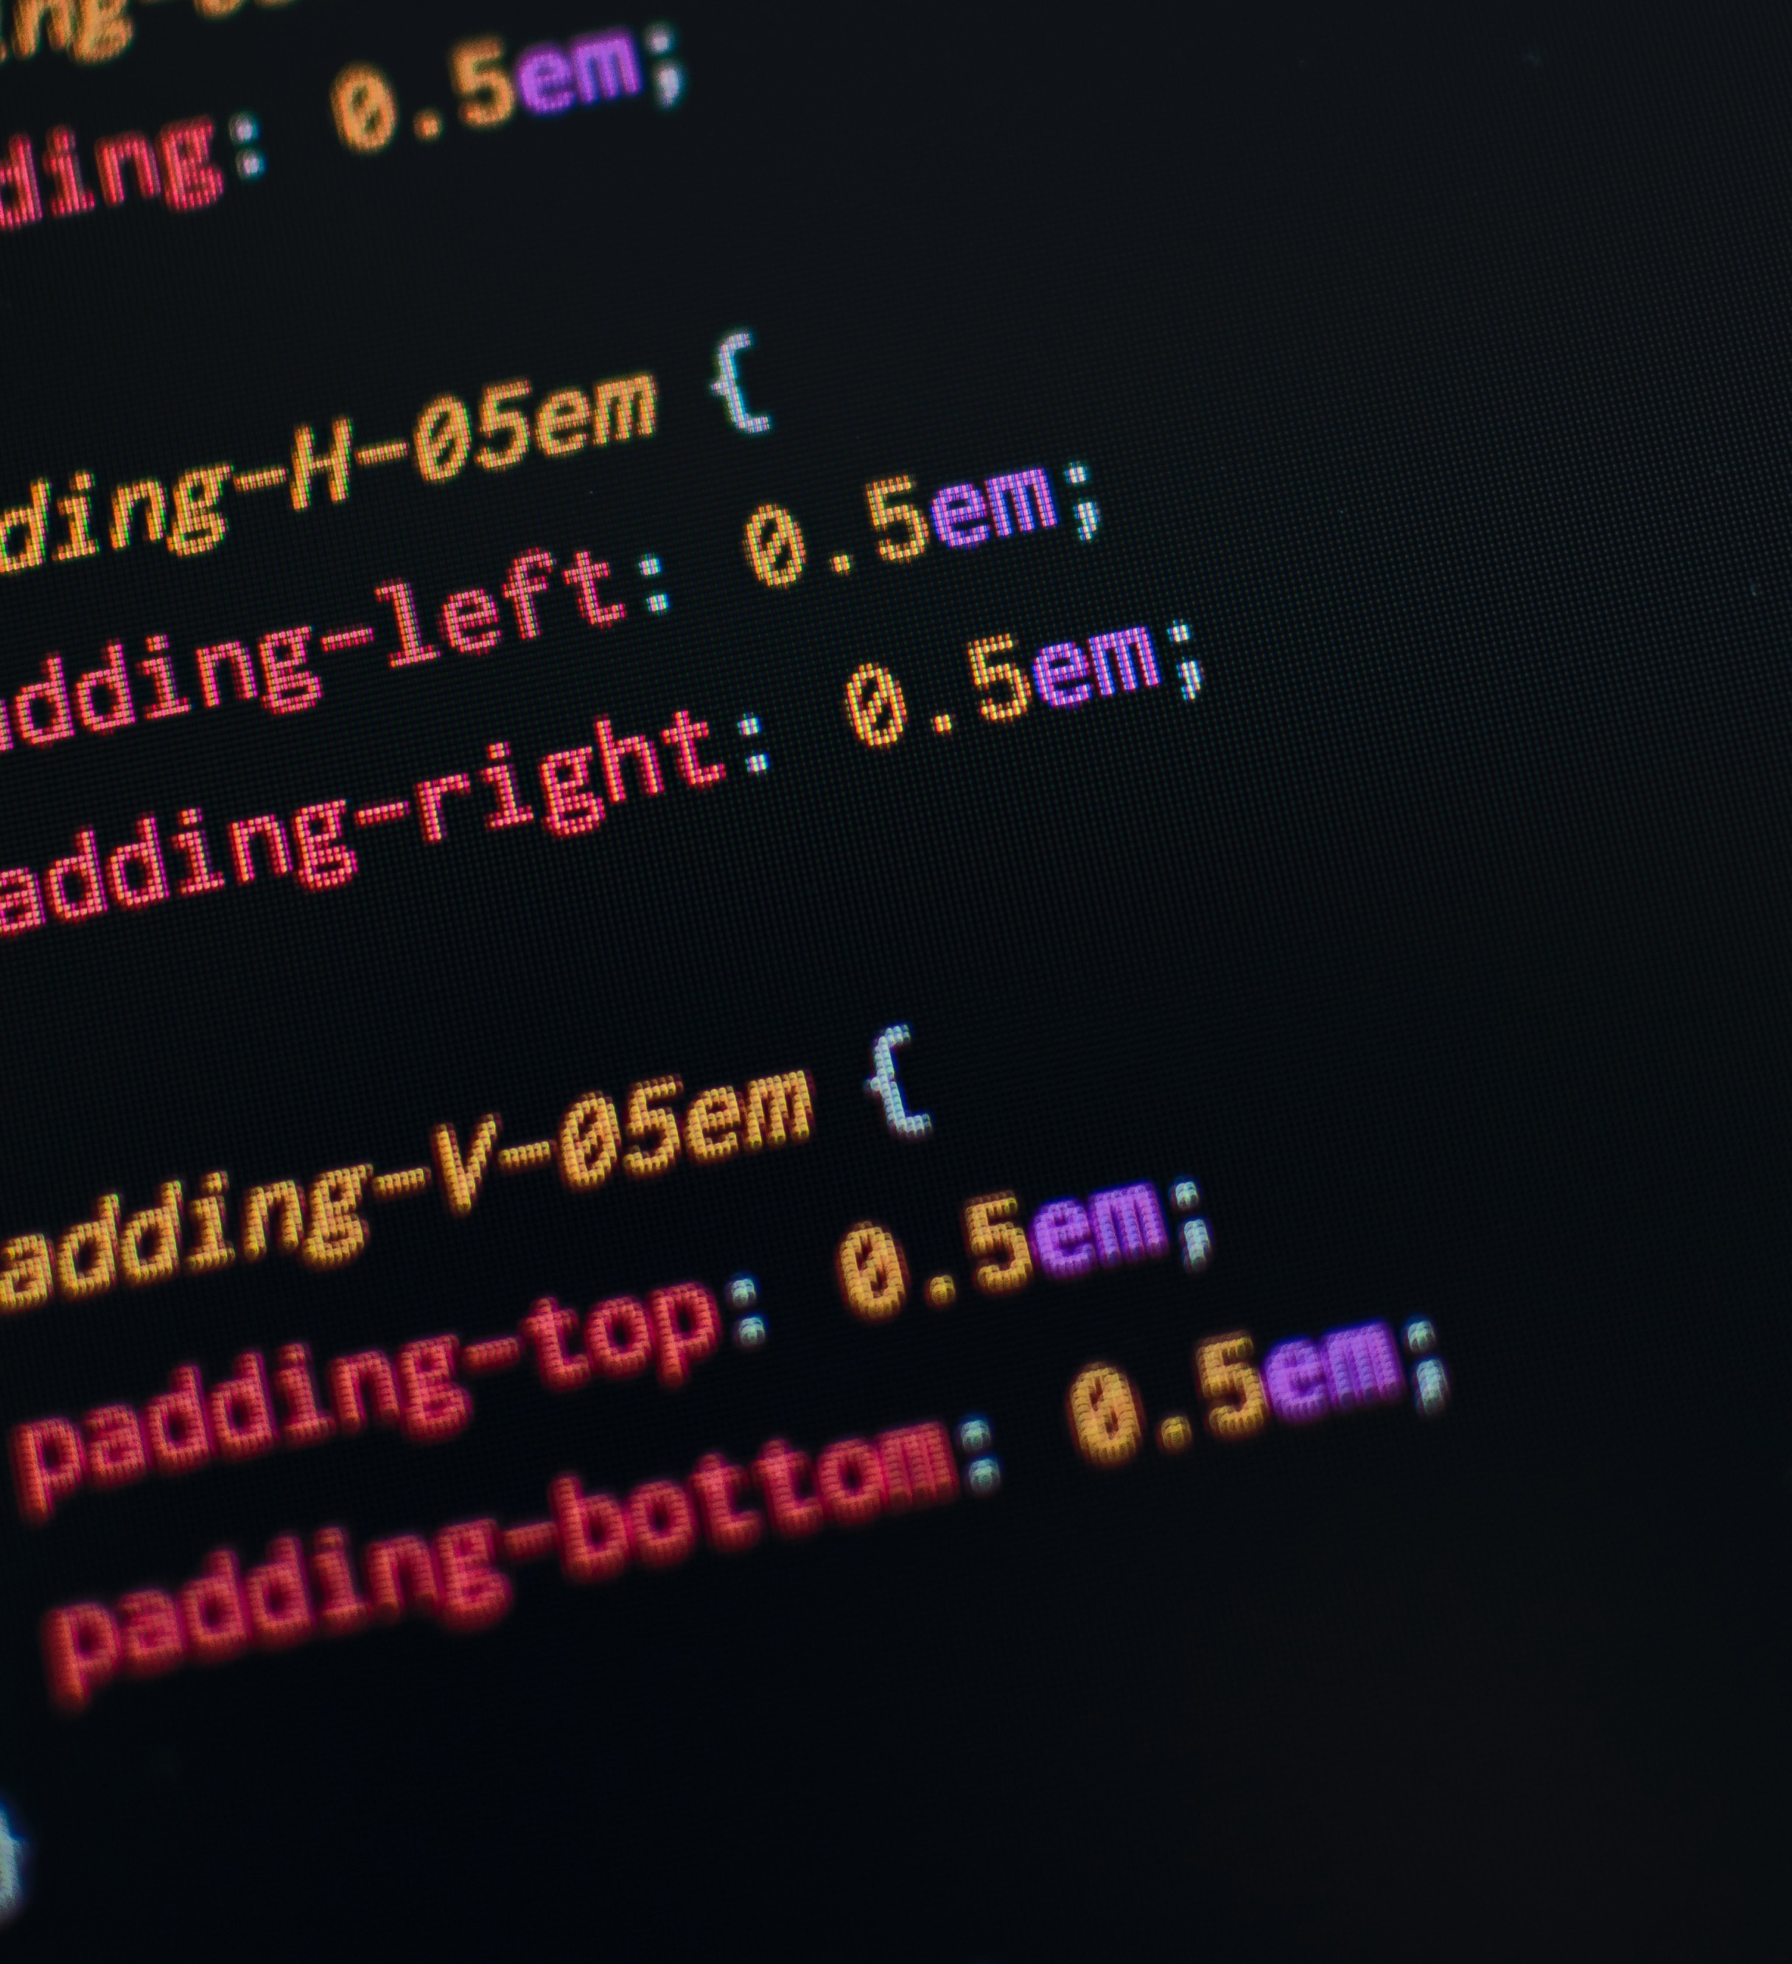

Technologies Used
02
React JS
React XML
Cascading Style Sheet (CSS)

Slide 4
Functions Created
03
addTransaction:- It handles user submitted transactions.
generateID:- It generates random id's for transactions.
removeTransactions:- It removes transactions when users clicks on delete button.
getTotalBalance:- It calculates the total balance by summing up all transaction amounts.
updateValues:- It updates values of balance,income and expense.

Slide 5
Benefits & Disbenefits
04
Advantages:
In this expense tracker app you can enter your income too.
It calculates overall balance too.
Disadvantages:
You cannot spend more than your income means you cannot add negative transactions (expense) more than your income.
You cannot add negative transactions (expense) when the balance is zero.

Slide 6
Thank You

